Slide 1
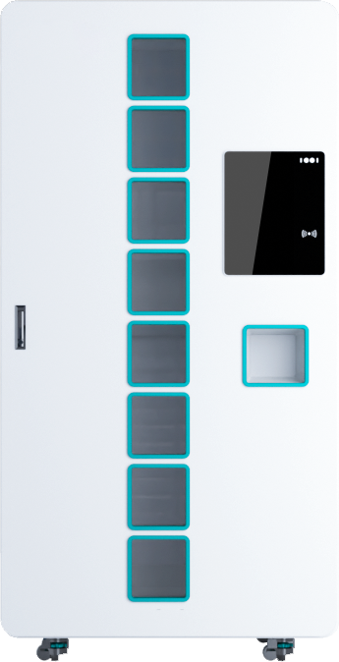
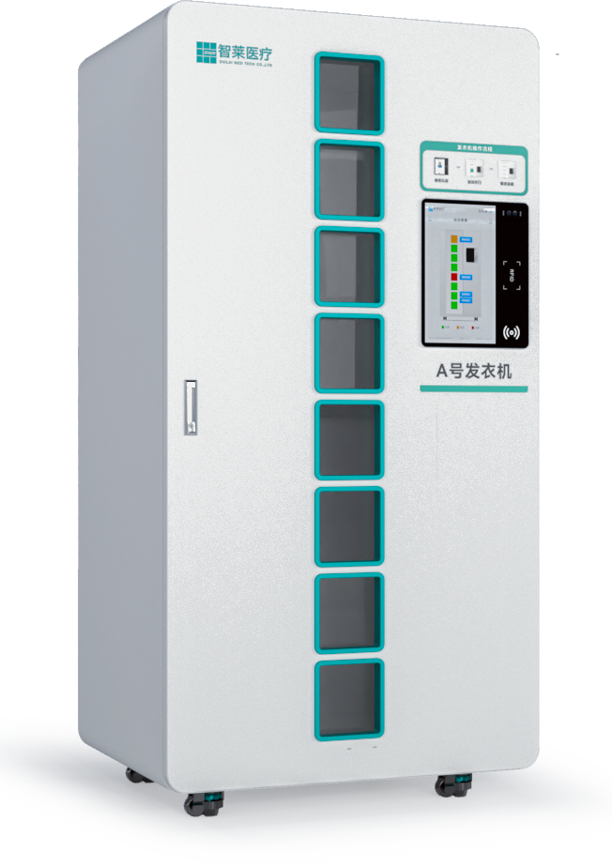
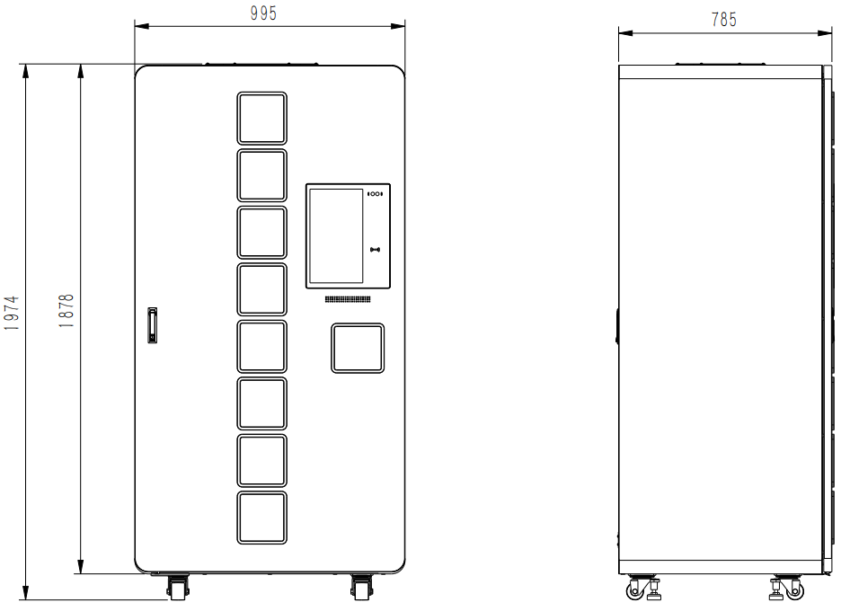
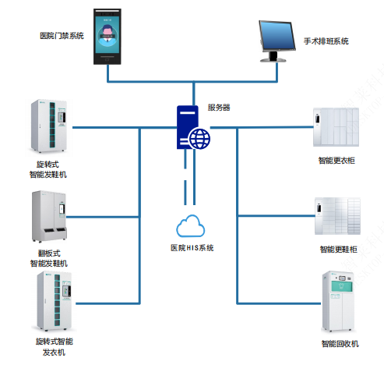
Smart Clothes Dispenser
Product Specification
Smart Clothes Dispenser
No. | Item | Parameters
1 | Outer dimension | 995mm*785mm*1974mm(W*D*H)
2 | Battery power | 128 suits; 16 slots/layers; 8 layers
3 | Weight | 350Kg
4 | Rated voltage | 220V/50Hz
5 | Rated power | 200W
6 | Clothes dispensing time | 3 seconds (average clothes dispensing time)
7 | Display | 15.6”all-in-one display
8 | ID recognition | Multiple recognition methods supported: face recognition, IC card, account and password, etc.
9 | RFID operating frequency | 902MHz～928MHz
10 | Disinfection device | In-locker disinfection supported; PS-400T plasma disinfection
11 | Operating system | Android, Windows
Product Features
Large storage capacity: 128 suits.
Small floor area: only 0.7m²
Quick dispensing: less than 3 seconds;
Smart reminder: light flashing and audio interaction;
8 pickup slots; anti-pinch function; non-contact dispensing; automatic ID binding; safe and reliable；
Automatic size selection; automatic dispensing. User-friendly operation interface; comprehensive management; smart replenishment reminder.
System solution
Hospital access control system
Surgery scheduling system
Server
Smart rotary shoes dispenser
Smart dressing locker
Smart flip-door shoes dispenser
Hospital HIS system
Smart shoes changing locker
Smart rotary clothes dispenser
Smart return locker

Slide 2
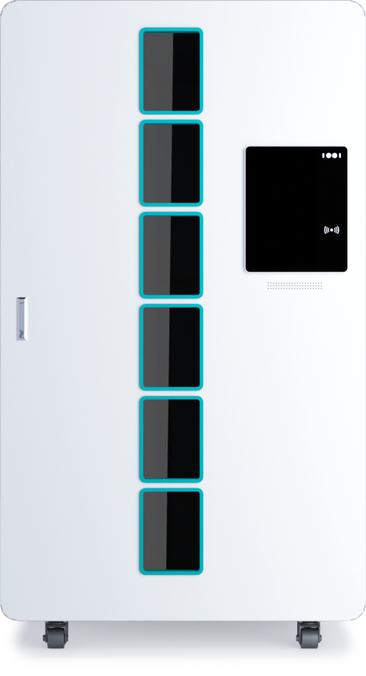
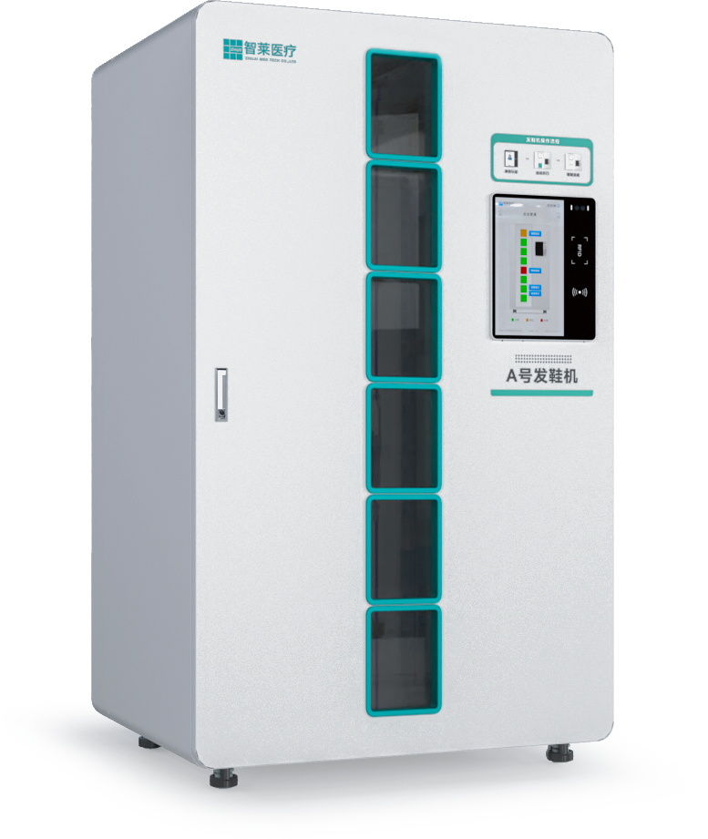
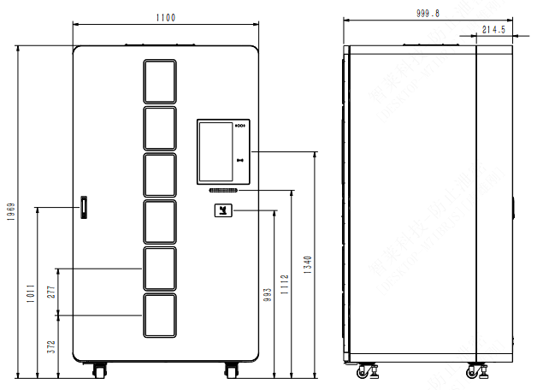
Smart Shoes Dispenser
Product Specification
Smart Shoes Dispenser
No. | Item | Parameters
1 | Outer dimension | 1100mm*1000mm*1969mm(W*D*H)
2 | Battery power | 114 pairs; 19 slots/layers; 6 layers
3 | Weight | 450Kg
4 | Rated voltage | 220V/50Hz
5 | Rated power | 200W
6 | Shoes dispensing time | 3 seconds (average shoes dispensing time)
7 | Display | 15.6”all-in-one display
8 | ID recognition | Multiple recognition methods supported: face recognition, IC card, account and password, etc.
9 | RFID operating frequency | 902MHz～928MHz
10 | Disinfection device | In-locker disinfection supported; PS-400T plasma disinfection
11 | Operating system | Android, Windows
Product Features
Large storage capacity: 114 pairs;
Small floor area: only 1.1m².
Quick dispensing: less than 3 seconds per pair;
Smart reminder: light flashing and audio interaction;
6 pickup slots; anti-pinch function; non-contact dispensing; automatic ID binding; safe and reliable；
Automatic size selection; automatic dispensing. User-friendly operation interface; comprehensive management; smart replenishment reminder.
System solution
Hospital access control system
Surgery scheduling system
Server
Smart rotary shoes dispenser
Smart dressing locker
Smart flip-door shoes dispenser
Hospital HIS system
Smart shoes changing locker
Smart rotary clothes dispenser
Smart return locker

Slide 3
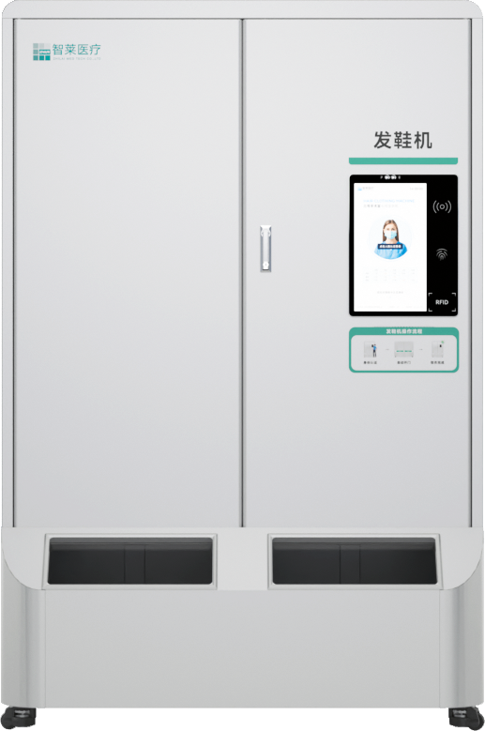
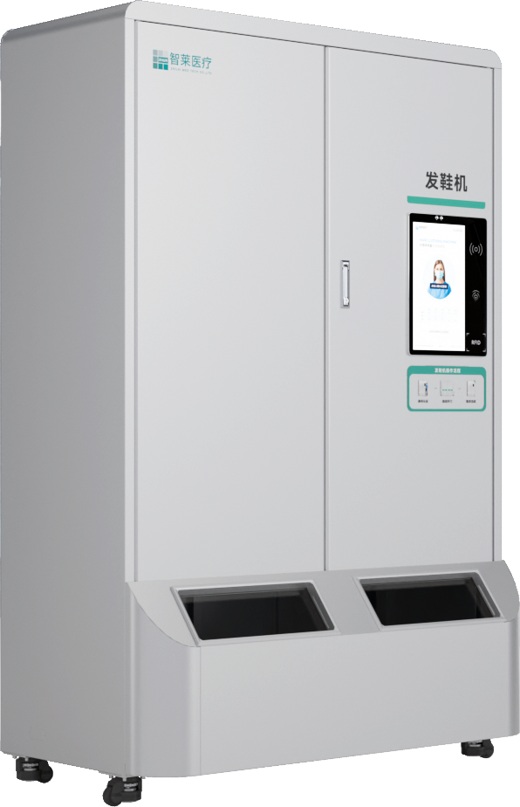
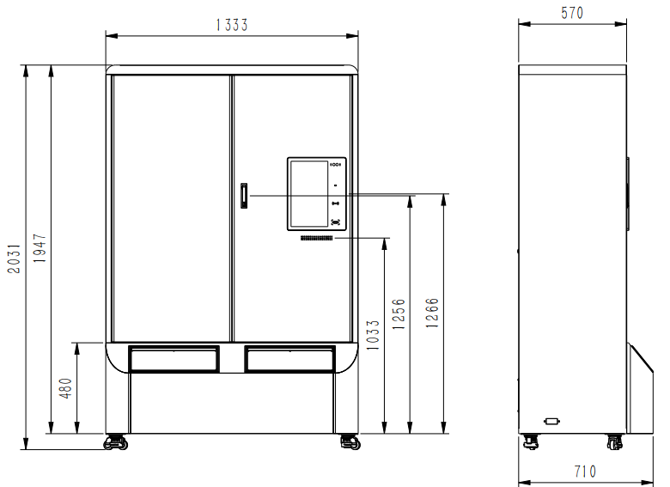
Smart Shoes Dispenser
Product Specification
Smart Shoes Dispenser
No. | Item | Parameters
1 | Outer dimension | 1333mm*710mm*2031mm(W*D*H)
2 | Battery power | 60 pairs for a starter; 30 pairs for an adder
3 | Weight | 420Kg
4 | Rated voltage | 220V/50Hz
5 | Rated power | 100W
6 | Shoes dispensing time | ＜3 seconds
7 | Display | 15.6”all-in-one display
8 | ID recognition | Multiple recognition methods supported: face recognition, IC card, account and password, etc.
9 | RFID operating frequency | 902MHz～928MHz
10 | Disinfection device | In-locker disinfection supported; PS-400T plasma disinfection
11 | Operating system | Android, Windows
Product Features
Shoes of multiple sizes can be stored;
Quick shoes dispensing: less than 3 seconds per pair;
Automatic ID information binding; replenishment reminder；
Dual shoes pickup doors; easy pickup; manual and smart replenishment modes;
Extension of starter/adder: starter cost is reduced while more surgical shoes are managed.；
Automatic size selection; automatic dispensing. User-friendly operation interface; comprehensive management; smart replenishment reminder.
System solution
Hospital access control system
Surgery scheduling system
Server
Smart rotary shoes dispenser
Smart dressing locker
Smart flip-door shoes dispenser
Hospital HIS system
Smart shoes changing locker
Smart rotary clothes dispenser
Smart return locker

Slide 4
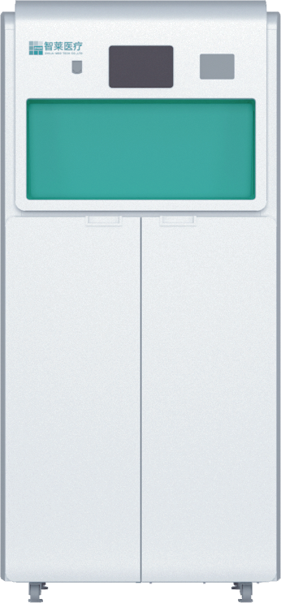
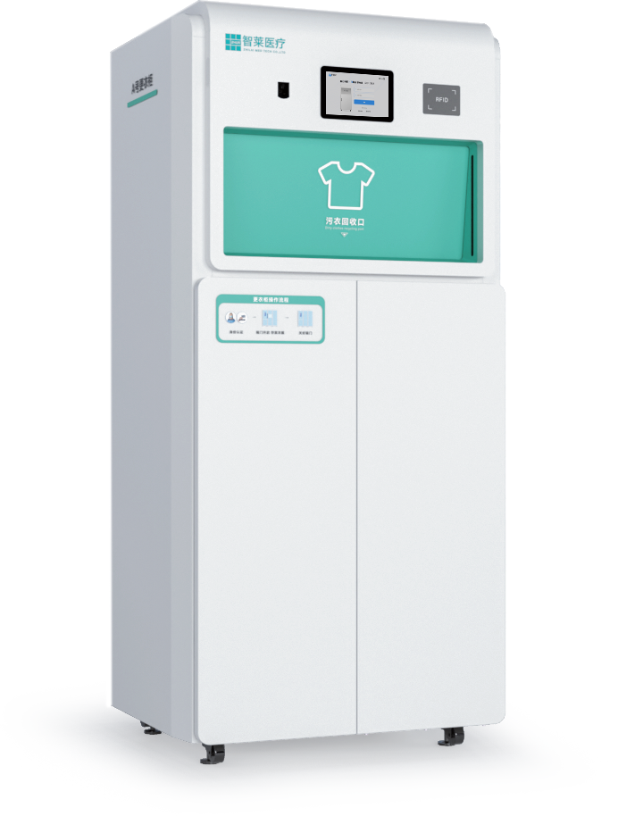
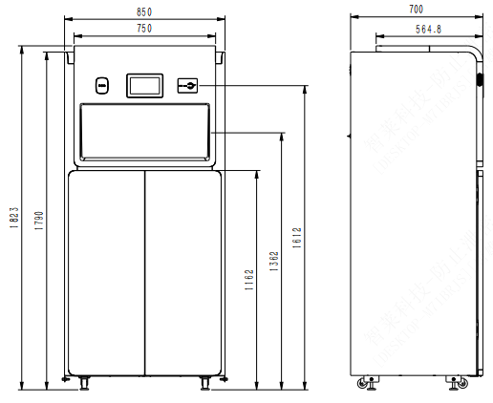
Smart Return Locker
Product Specification
Smart Return Locker
No. | Item | Parameters
1 | Outer dimension | 850mm*700mm*1823mm(W*D*H)
2 | Battery power | Dirty clothes: 50 suits; dirty shoes: 70 pairs
3 | Weight | 190Kg
4 | Rated voltage | 220V/50Hz
5 | Rated power | 150W
6 | Display | 7”all-in-one capacitive display
7 | Quick return | 1. Multiple recognition methods supported: face recognition, IC card, account and password, etc.； 2. Infrared approaching detection for clothes/shoes return; when the clothes/shoes are approaching, the return door opens automatically; automatic return recognition RFID and audio reminder for return status.
8 | RFID operating frequency | 902MHz～928MHz
9 | Disinfection device | In-locker ultra violate light disinfection supported
10 | Operating system | Android, Windows
Product Features
28” extra-large return slot: avoid piling of clothes/shoes.
Small floor area: only 0.6m²
Quick return: response within 3 seconds
Non-contact and non-inductive return; infrared + RFID monitoring of clothes return behavior; full locker alarm; ultraviolet disinfection;
Anti-pinch return; power-off and off-line operation supported.；
Automatic records of return information; report to management system. Smart excess reminder; timely reminder for cleaning;
System solution
Hospital access control system
Surgery scheduling system
Server
Smart rotary shoes dispenser
Smart dressing locker
Smart flip-door shoes dispenser
Hospital HIS system
Smart shoes changing locker
Smart rotary clothes dispenser
Smart return locker

Slide 5
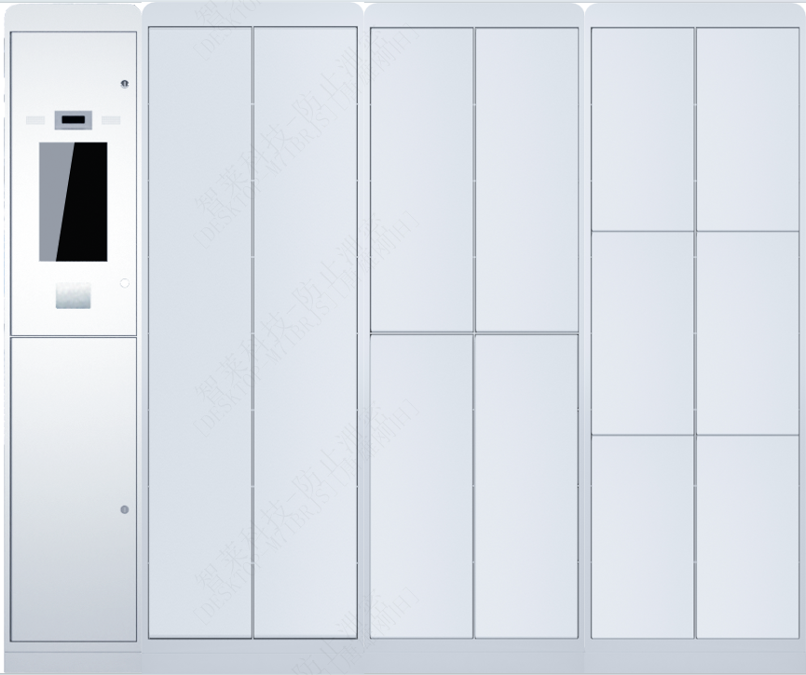
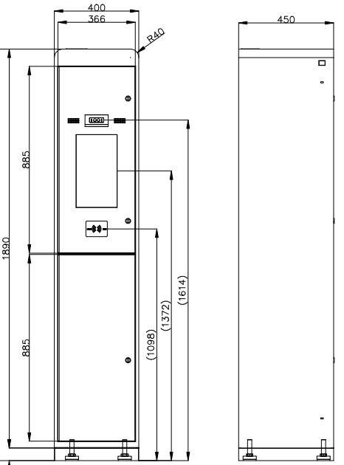
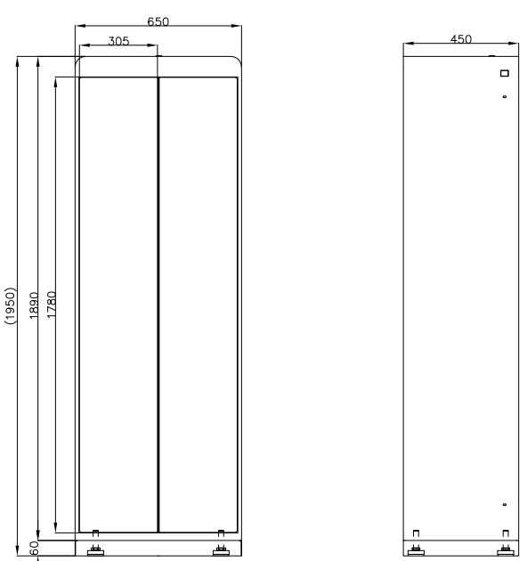
Smart Dressing Locker
Product Specification
Smart Dressing Locker
No. | Item | Parameters
1 | Outer dimension | Starter: 400mm*450*1950mm（W*D*H） Adder: 650mm*450*1950mm（W*D*H）
2 | Slot dimension | 2-Door adder dimension: 269mm*429mm*1770mm（W*D*H） 4-Door adder dimension: 269mm*429mm*877mm（W*D*H） 6-Door adder dimension: 269mm*429mm* 576mmW*）
3 | Weight | Starter: 45Kg; adder: 70Kg
4 | Rated voltage | 220V/50Hz
5 | Rated power | Starter: 85W; adder: 10W
6 | Display | 15.6” capacitive display
7 | Product lock control | The electric lock is designed with 360° tamper resistance function and the device which can prevent insertion of soft piece; door status detection;
8 | ID recognition | Multiple recognition methods supported: face recognition, IC card, account and password, etc.
9 | Disinfection device | In-locker ozone disinfection supported
10 | Operating system | Android, Windows
Product Features
Highly safe: the device is tamper resistant and anti-theft；
Smart system: related slots are distributed properly as per actual application scenarios;
Door detection: if the door is not closed normally, the audio prompt is triggered immediately；
Flexible combination: multiple columns of lockers can be combined as per on-site requirement.；
Remote control; flexible configuration for fixed locker and mobile locker; exception reminder, etc.
Proximity allocation; user-defined ID information for proper locker opening position and height.
System solution
Hospital access control system
Surgery scheduling system
Server
Smart rotary shoes dispenser
Smart dressing locker
Smart flip-door shoes dispenser
Hospital HIS system
Smart shoes changing locker
Smart rotary clothes dispenser
Smart return locker

Slide 6
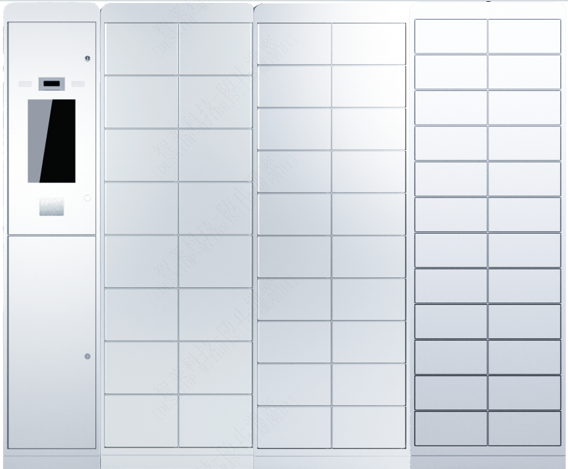
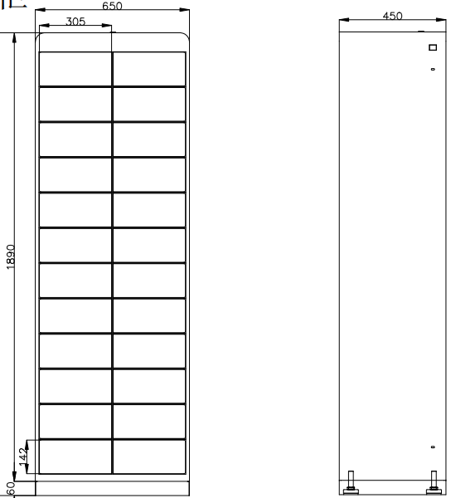
Smart Shoes Change Locker
Smart Shoes Change Locker
No. | Item | Parameters
1 | Outer dimension | Starter: 400mm*450*1950mm（W*D*H）, Adder: 650mm*450*1950mm（W*D*H）
2 | Slot dimension | 8-Door adder dimension: 269mm*429mm*428mm（W*D*H） 10-Door adder dimension: 269mm*429mm*339mm（W*D*H） 12-Door adder dimension: 269mm*429mm*280mm（W*D*H） 16-Door adder dimension: 269mm*429mm*206mm（W*D*H） 20-Door adder dimension: 269mm*429mm*162mm（W*D*H） 24-Door adder dimension: 269mm*429mm*132mm（W*D*H）
3 | Weight | Starter: 45Kg; adder: 100Kg
4 | Rated voltage | 220V/50Hz
5 | Rated power | Starter: 85W; adder: 10W
6 | Display | 15.6” capacitive display
7 | Product lock control | The electric lock is designed with 360° tamper resistance function and the device which can prevent insertion of soft piece; door status detection;
8 | ID recognition | Multiple recognition methods supported: face recognition, IC card, account and password, etc.
9 | Disinfection device | In-locker Ozone disinfection supported
10 | Operating system | Android, Windows
Product Specification
Product Features
Highly safe: the device is tamper resistant and anti-theft；
Smart system: related slots are distributed properly as per actual application scenarios;
Door detection: if the door is not closed normally, the audio prompt is triggered immediately；
Flexible combination: multiple columns of lockers can be combined as per on-site requirement.；
Remote control; flexible configuration for fixed locker and mobile locker; exception reminder, etc.
Proximity allocation; user-defined ID information for proper locker opening position and height.
System solution
Hospital access control system
Surgery scheduling scheduling system
Server
Smart rotary shoes dispenser
Smart dressing locker
Smart flip-door shoes dispenser
Hospital HIS system
Smart shoes changing locker
Smart rotary clothes dispenser
Smart return locker

Slide 7
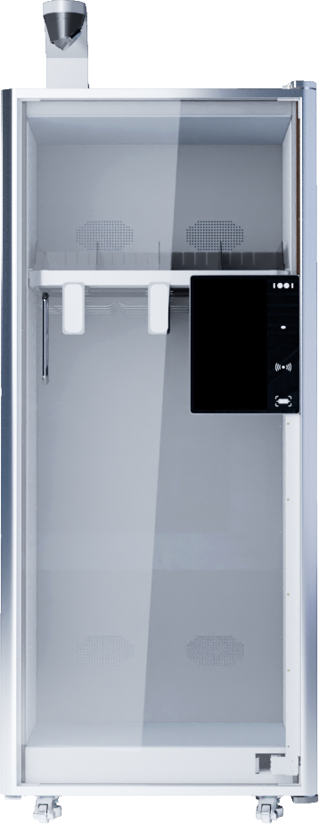
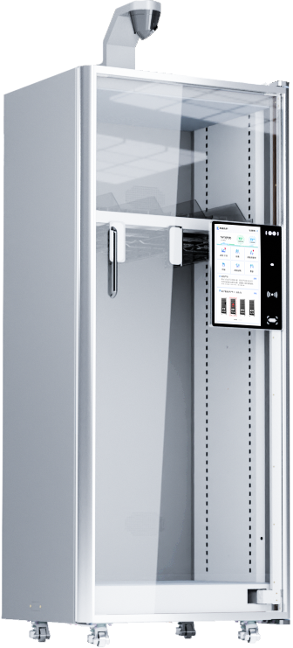
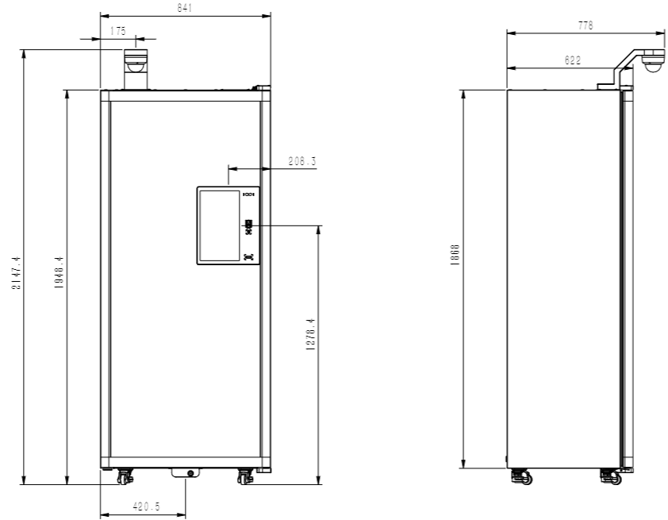
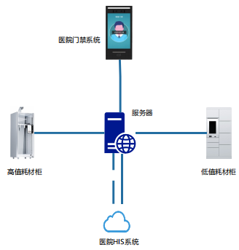
High-value Consumable Locker
Product Specification
High-value Consumable Locker
No. | Item | Parameters
1 | Outer dimension | 841mm*624mm* 1948mm (W*D*H)
2 | Battery power | Over 600L
3 | Weight | Starter: 150Kg; adder: 95Kg
4 | Rated voltage | 220V/50Hz
5 | Rated power | Starter: 180W; adder: 20W
6 | Display | 15.6”all-in-one capacitive display
7 | Door opening method | Door opening by electric control; face recognition, fingerprint, finger vein, IC card
8 | Recognition method | RFID recognition (UHF RFID)
9 | Frequency range | 902~928MHz FCC
10 | Locker type | Flexible combination of laminate and conduit
11 | Disinfection device | In-locker plasma disinfection supported;
12 | Stock check time | Reading time less than 3S.; reading accuracy> 99.5%.
13 | Operating system | Android, Windows
Product Features
IoT RFID technology; smart perception of item storage/pickup;
Free configuration of conduit, laminate and other modules；
Ream-time stock management; one code for one item; whole-process traceability management;
Automatic stock check; real-time monitoring of consumables data; timely alarm for safety stock;
Integration with the hospital staff system for different operation permission settings; consumables can be used in a more safe and confidential way.
System solution
Hospital access control system
Server
Locker for high-value consumables
Locker for low-value consumables
Hospital HIS system

Slide 8
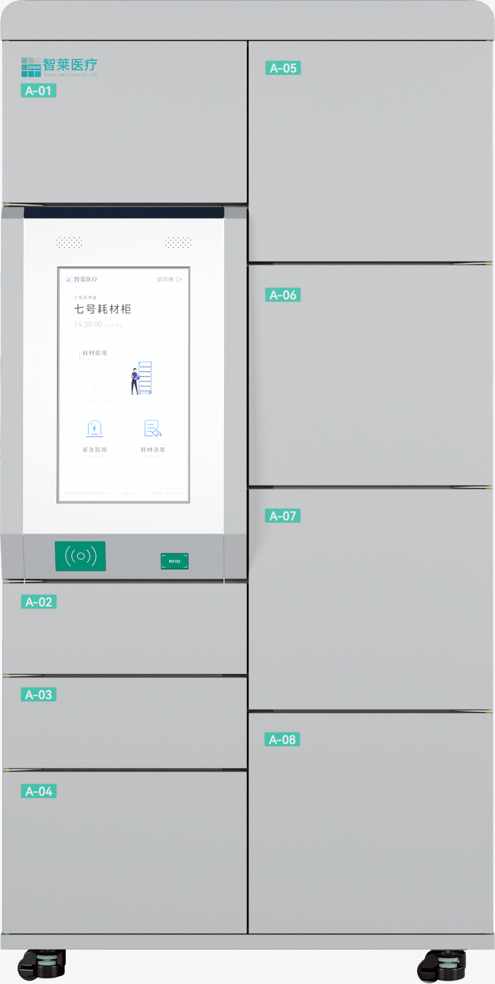
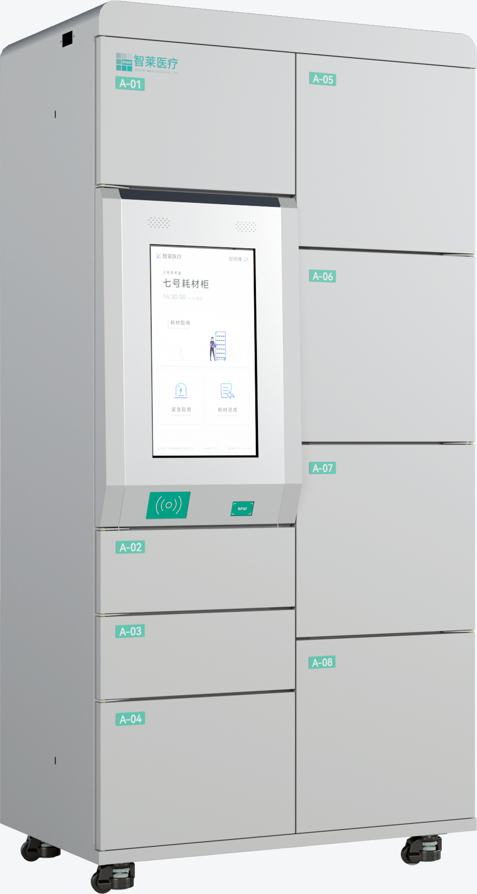
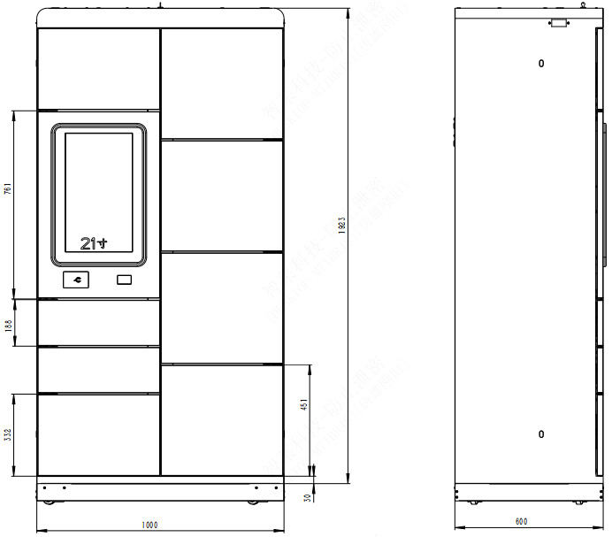
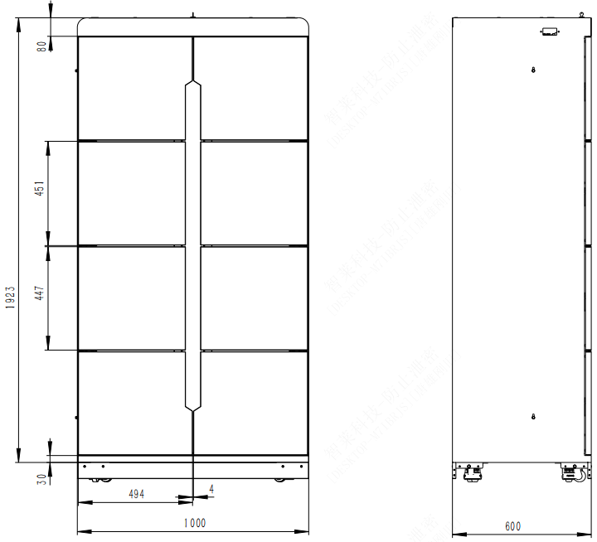
Low-value Consumable Locker
Product Specification
Low-value Consumable Locker
No. | Item | Parameters
1 | Outer dimension | 1000mm*600mm* 1923mm(W*D*H)
2 | Slot dimension | S slot 494mm*571mm* 188mm（W*D*H） M slot 494mm*571mm* 332mm（W*D*H） L slot 494mm*571mm*451mm（W*D*H)
3 | Weight | Starter: 150Kg; adder: 95Kg
4 | Rated voltage | 220V/50Hz
5 | Rated power | Starter: 180W; adder: 20W
6 | Display | 21.5”all-in-one capacitive display
7 | Door opening method | Door opening by electric control; face recognition, fingerprint, finger vein, IC card
8 | Operating system | Android, Windows
Product Features
Flexible locker model configuration: 4-door; 8-door; 16-door;
Integrated operation; 12.5” large screen;
Back power; UPS capacity for 1 hour operation; the locker can be used normally in case of power failure;
It is applicable for many hospital departments; a wide range of consumables can be managed;
Both charging consumables and non-charging consumables can be managed;
System solution
Hospital access control system
Server
Locker for high-value consumables
Locker for low-value consumables
Hospital HIS system

Slide 9
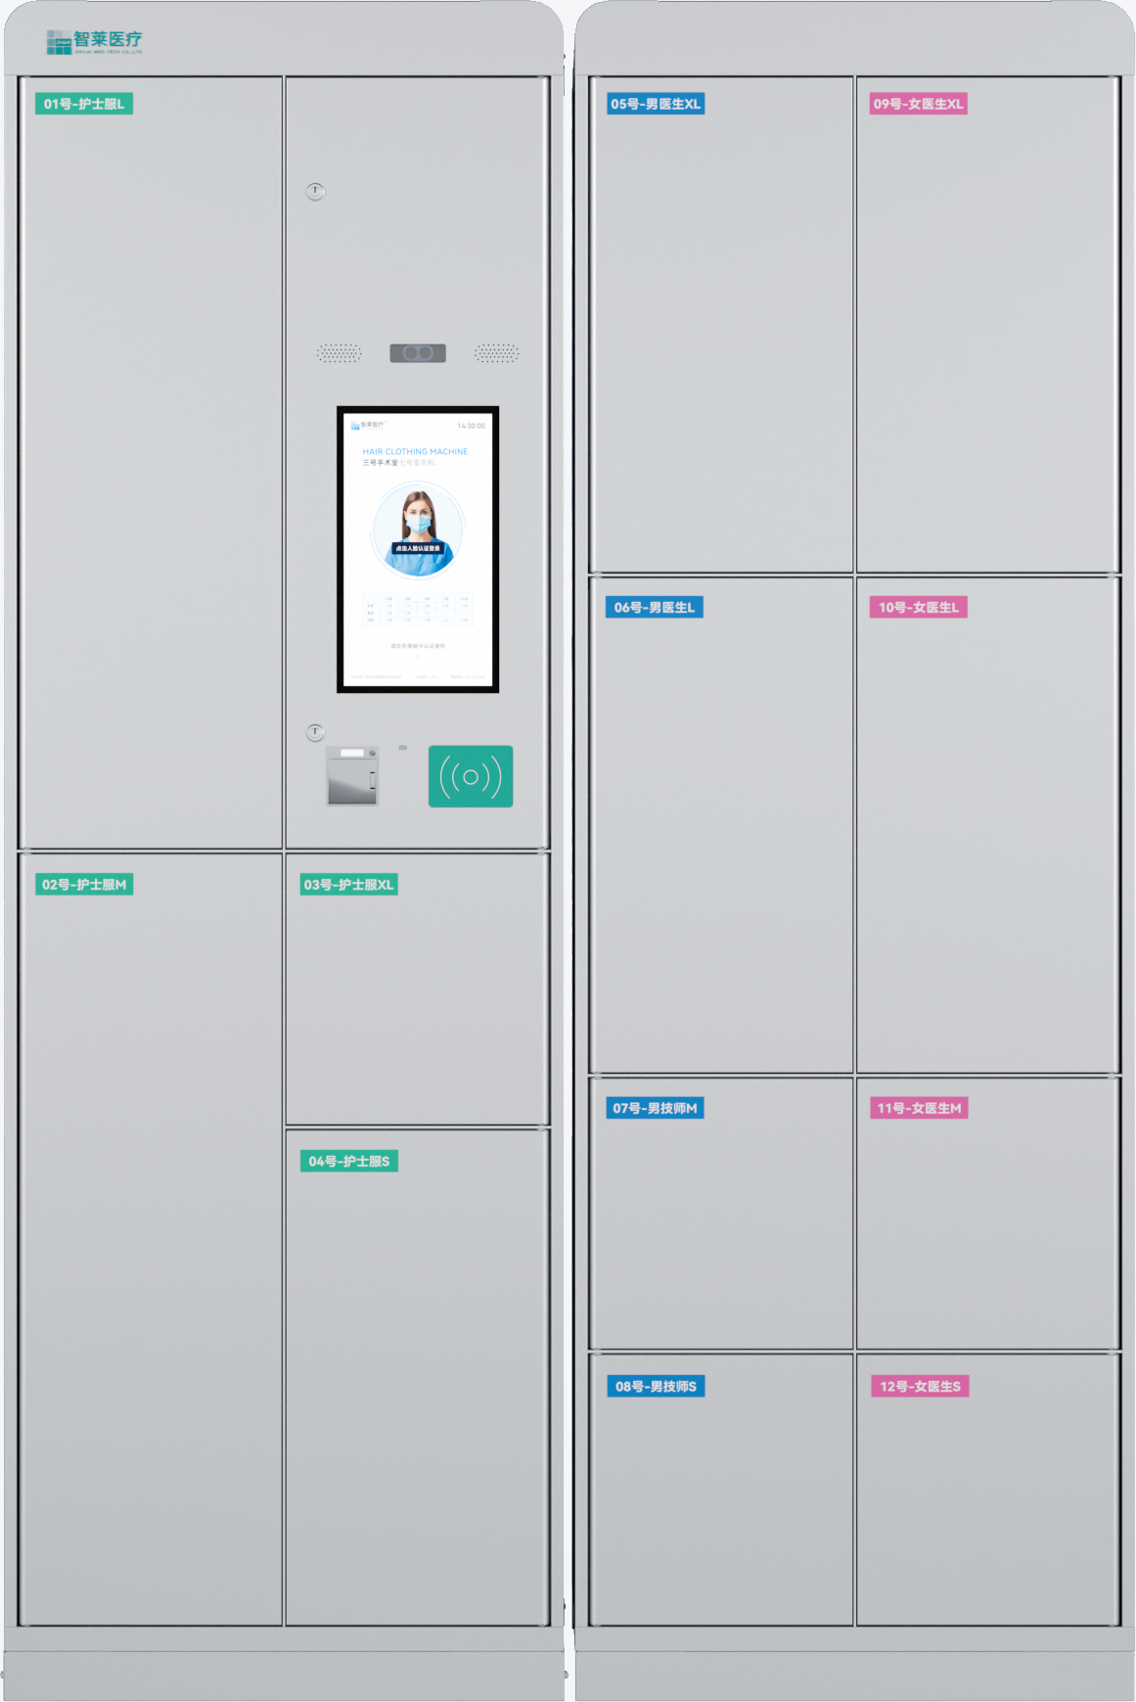
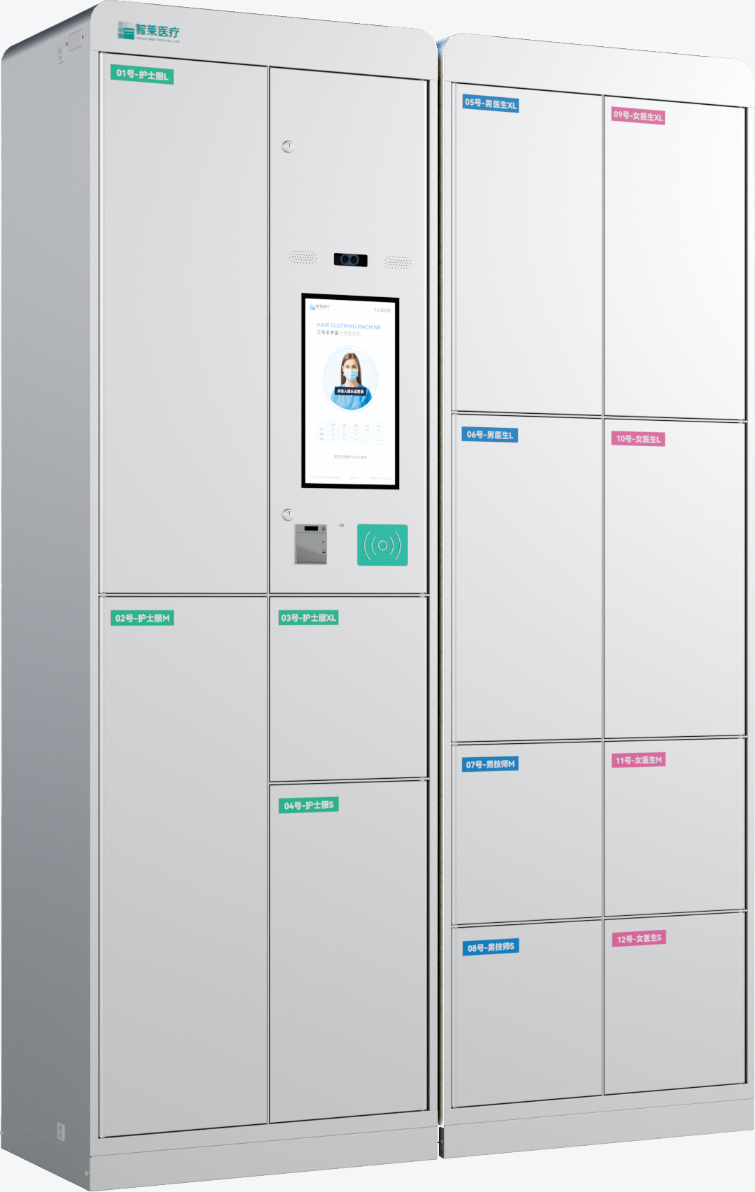
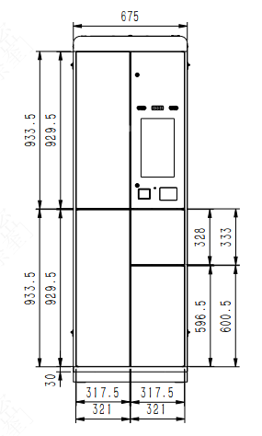
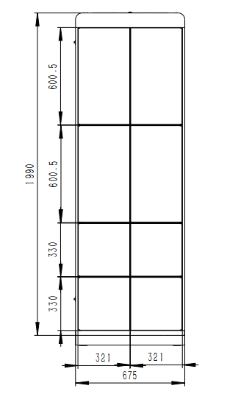
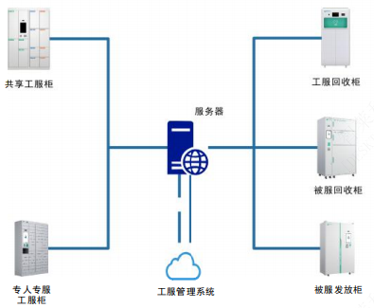
Shared Work Wear Locker
Product Specification
Shared Work Wear Locker
No. | Item | Parameters
1 | Outer dimension | 675mm*450mm* 1990mm (W*D*H)
2 | Battery power | Nurse suit (coat + pants) S\M\L\XL: 18 suits/28 suits/26 suits/10 suits Female doctor S\M\L\XL: 10 suits/18 suits/18 suits/10 suits Male doctor S\M\L\XL: 10 suits/10 suits/18 suits/18 suits
3 | Weight | Starter: 100Kg\ adder: 100Kg
4 | Rated voltage | 220V/50Hz
5 | Rated power | Starter: 100W; adder: 10W
6 | Display | 15.6” capacitive display
7 | Door opening method | Door opening by electric control; face recognition; IC card
8 | Recognition method | RFID recognition (UHF RFID); build-in RFID antenna
9 | Frequency range | 902~928MHz FCC
10 | Stock check time | Single slot stock check；reading time less than 3S.; reading accuracy> 99.5%.
11 | Operating system | Android, Windows
Product Features
Highly safe: the device is tamper resistant and anti-theft；
Multiple login verification methods: face recognition, IC card; more convenient and efficient;
Smart stock management; in case of insufficient stock, a friendly reminder will be sent to remind the staff to replenish;
Smart RFID stock check; efficient and quick;
RFID shielding design; unique software algorithm to prevent wrong reading or missed reading.
System solution
Shared work wear locker
Work wear return locker
Server
Bedding return locker
Dedicated work wear locker
Work wear management system
Bedding dispensing locker

Slide 10
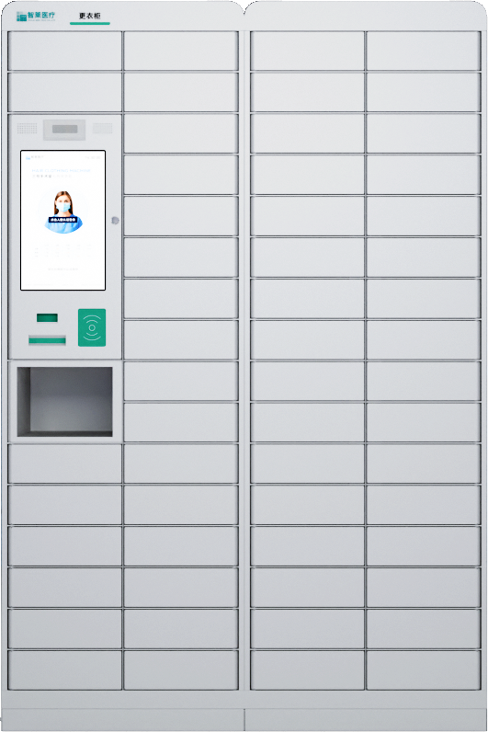
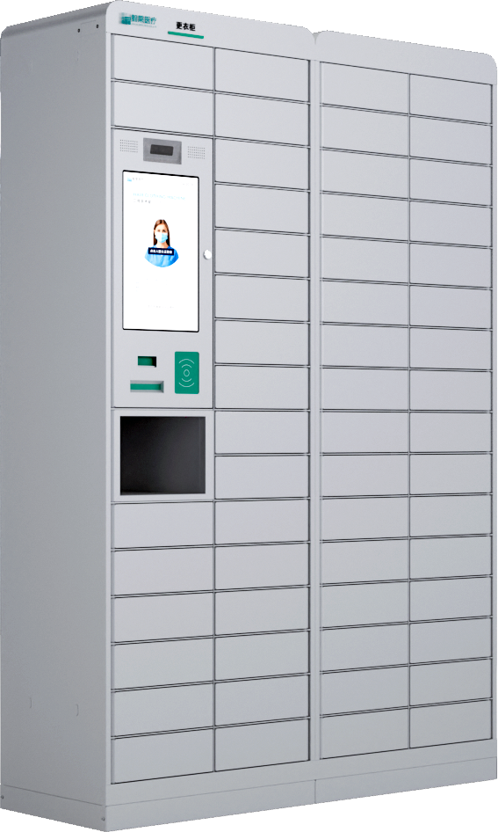
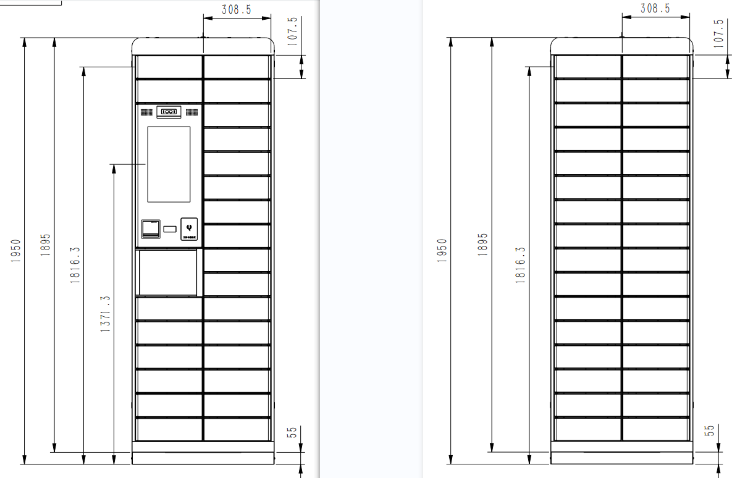
Dedicated Work Wear Locker
Product Specification
Dedicated Work Wear Locker
No. | Item | Parameters
1 | Outer dimension | 650mm*450mm* 1950mm (W*D*H)
2 | Sot dimension | 255mm*424mm* 101mm (W*D*H)
3 | Weight | Starter: 100Kg\ adder: 90Kg
4 | Rated voltage | 220V/50Hz
5 | Rated power | Starter: 100W; adder: 10W
6 | Display | 15.6” capacitive display
7 | Door opening method | Door opening by electric control; face recognition; IC card
8 | Recognition method | RFID recognition (UHF RFID))
9 | Frequency range | 902~928MHz FCC
10 | Operating system | Android, Windows
Product Features
It is used to dispense, store and distribute clean work wear;
Automatic records of replenishment data; reduced handover time;
Automatic records of pickup data; traceability of pickup data;
Update and upload of in-locker stock data;
In case of insufficient stock, a friendly reminder will be sent to remind the staff to replenish.
System solution
Shared work wear locker
Work wear return locker
Server
Bedding return locker
Dedicated work wear locker
Work wear management system
Bedding dispensing locker

Slide 11
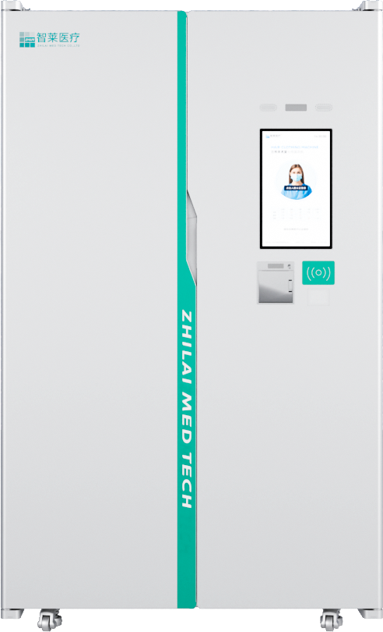
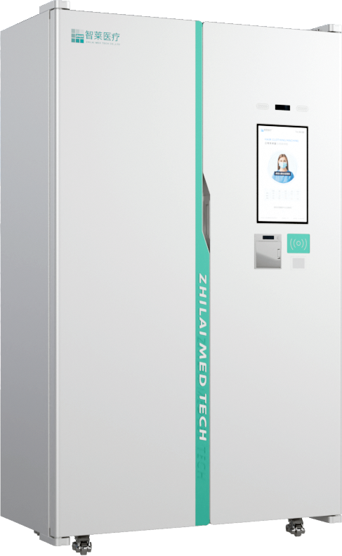
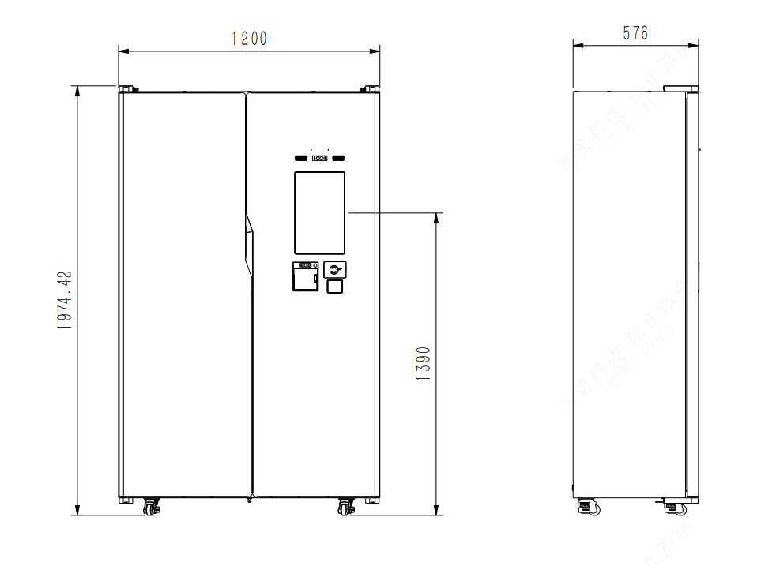
Bedding Locker
Product Specification
Bedding Locker
No. | Item | Parameters
1 | Outer dimension | 1200mm*576mm* 1975mm (W*D*H)
2 | Battery power | ＞200 sets (quilt cover, bed sheet, pillowslip)
3 | Weight | Starter: 160Kg\ adder: 150Kg
4 | Rated voltage | 220V/50Hz
5 | Rated power | Starter: 110W; adder: 20W
6 | Display | 15.6” capacitive display
7 | Door opening method | Door opening by electric control; face recognition; IC card
8 | Recognition method | RFID recognition (UHF RFID))
9 | Frequency range | 902~928MHz FCC
10 | Stock check time | Reading time less than 3S.; reading accuracy> 99.5%.
11 | Operating system | Android, Windows
Product Features
It is used to dispense, store and distribute clean beddings.
Multiple login verification methods: face recognition, IC card; more convenient and efficient;
Automatic records of replenishment data; reduced handover time;
Automatic records of pickup data; traceability of pickup data;
Update and upload of in-locker stock data;
In case of insufficient stock, a friendly reminder will be sent to remind the staff to replenish.
System solution
Shared work wear locker
Work wear return locker
Server
Bedding return locker
Dedicated work wear locker
Work wear management system
Bedding dispensing locker

Slide 12
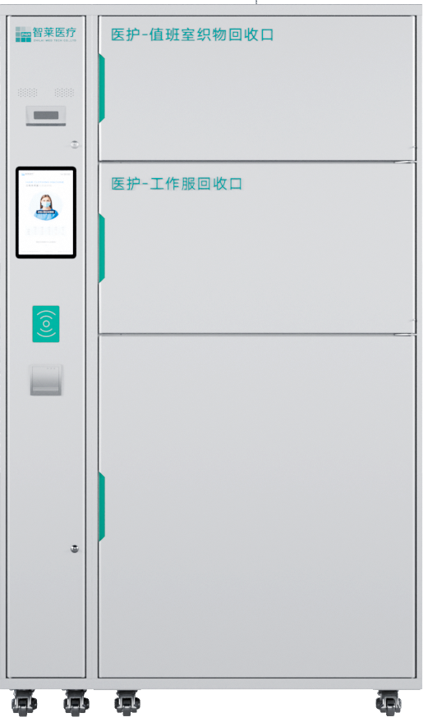
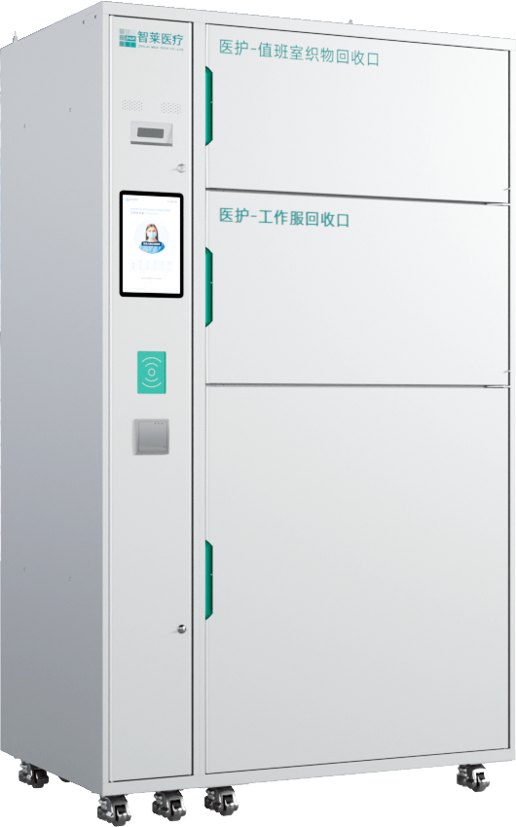
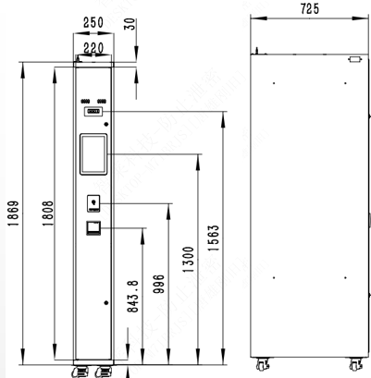
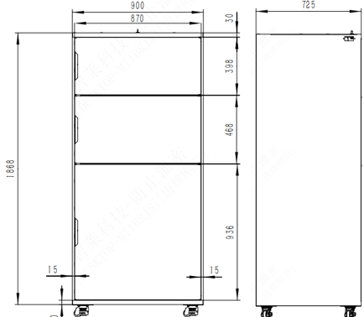
Bedding Return Locker
Product Specification
Bedding Return Locker
No. | Item | Parameters
1 | Outer dimension | Starter: 250mm*725mm* 1955mm（W*D*H） Adder: 900mm*725mm* 1955mm（W*D*H）
2 | Sot dimension | Upper slot： 870mm*700mm* 412mm（W*D*H） M slot 870mm*700mm* 485mm（W*D*H） Lower slot: 870mm*700mm* 970mm（W*D*H）
3 | Weight | Starter: 50Kg\ adder: 150Kg
4 | Rated voltage | 220V/50Hz
5 | Rated power | Starter: 80W; adder: 20W
6 | Display | 10.1” capacitive display
7 | Door opening method | Door opening by electric control; face recognition; IC card
8 | Recognition method | RFID recognition (UHF RFID))
9 | Frequency range | 902~928MHz FCC
10 | Stock check time | Single slot stock check；reading time less than 3S.; reading accuracy> 99.5%.
11 | Operating system | Android, Windows
Product Features
Multiple login verification methods: face recognition, IC card; more convenient and efficient;
It is used to return different categories of dirty fabrics;
Automatic recognition of the distributed fabric category and quantity;
Automatic records of return data；
Active full locker alarm will be triggered to remind nursing workers to clean in time.
System solution
Shared work wear locker
Work wear return locker
Server
Bedding return locker
Dedicated work wear locker
Work wear management system
Bedding dispensing locker

Slide 13
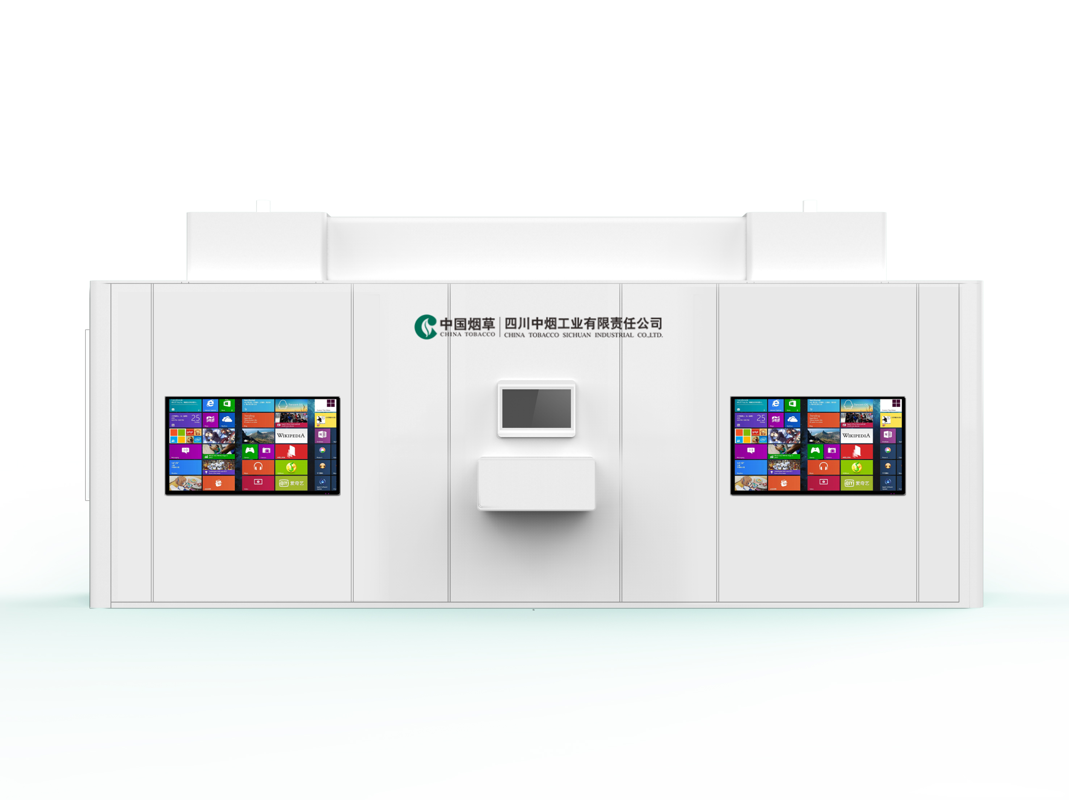
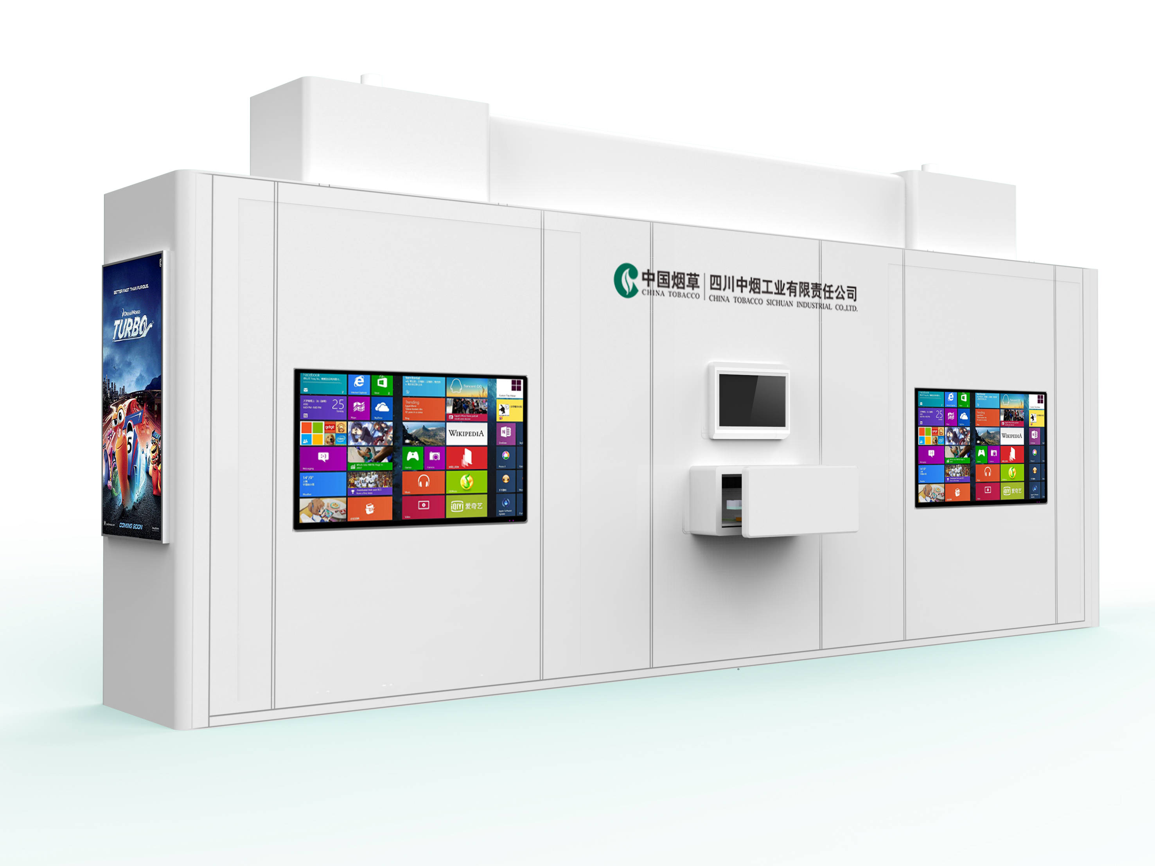
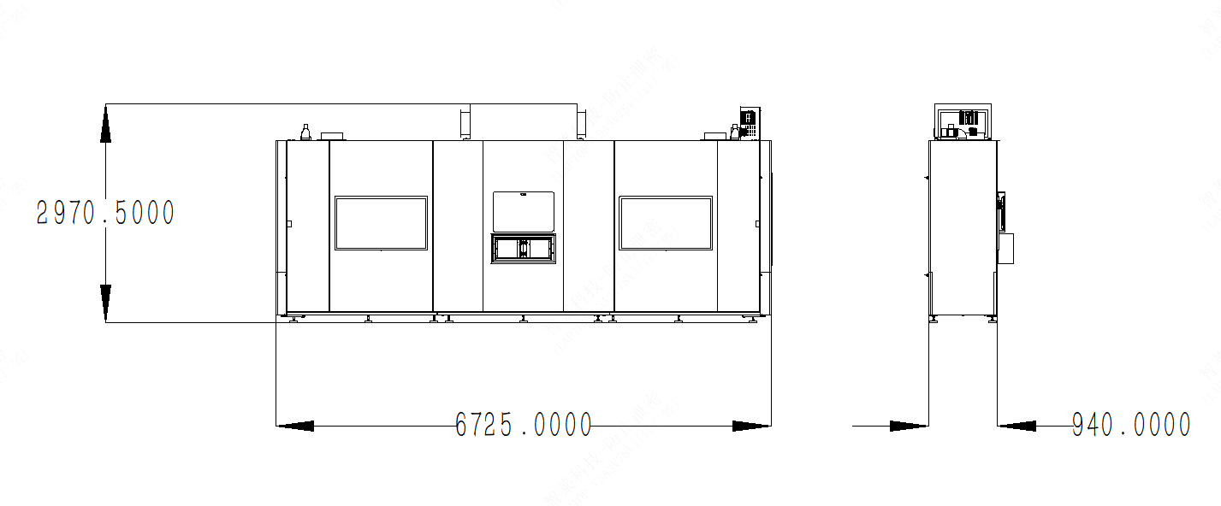
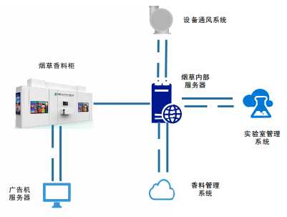
Tobacco and Spice locker
Product Specification
Tobacco and Spice locker
No. | Item | Parameters
1 | Outer dimension | 6725mm*940mm* 2970mm (W*D*H)
2 | Battery power | 1700 bottles
3 | Weight | 2.2T
4 | Rated voltage | 220V/50Hz
5 | Rated power | 6000W
6 | Display | 32” all-in-one touch display, 55”Advertising screen(optional)
7 | Storage temperature | 8℃~25℃
8 | Single storage/pickup capacity | 10 bottles
9 | Storage/pickup date | 10 bottles/ single storage/pickup; less than 180 seconds
10 | Operating system | Android, Windows
Product Features
Split design: easier transportation and application scenario matching. Clamping claw is designed with smart components, which can recognize spices efficiently and accurately;
Man-machine interaction; highly safe design; anti-crash and anti-pinch design;
Large storage capacity: 1700 bottles. Constant temperature control for the whole locker; smart ±1.5° temperature difference adjustment;
Multi-media display; user-defined spice information and advertising information for display; options of multiple types of advertising screens ;
In-locker ventilation system: avoid leakage of spice odor; more friendly.
System solution
Ventilation system
Tabacco and spice locker
Internal server
Lab management system
Advertising machine server
Spice management system

Slide 14
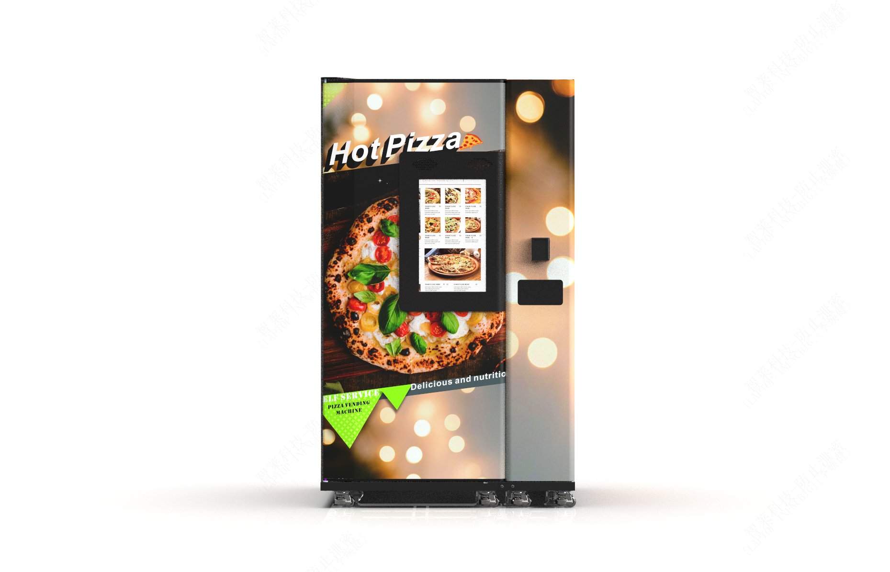
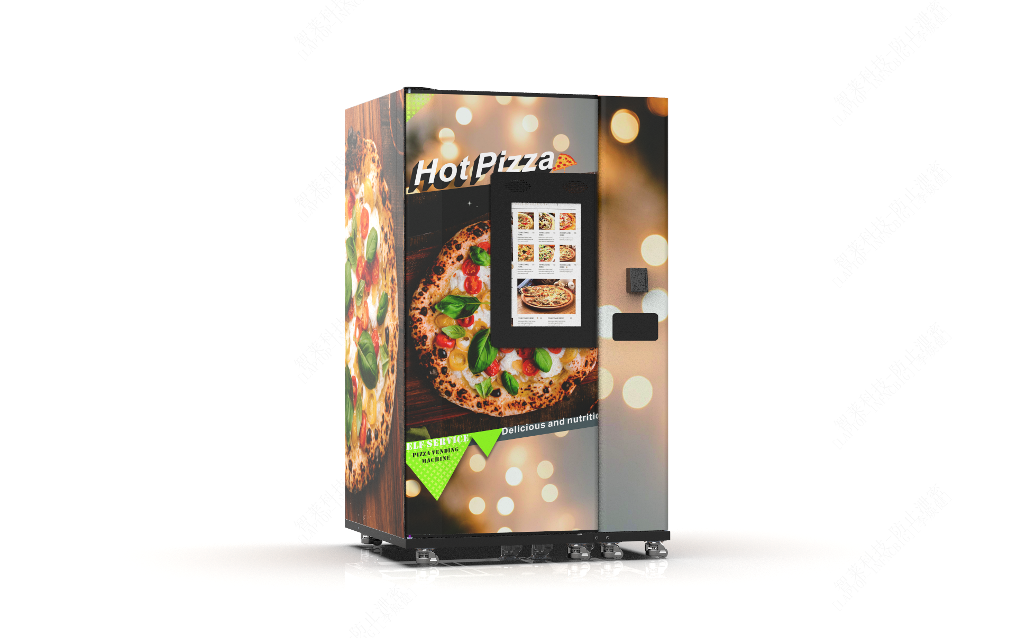
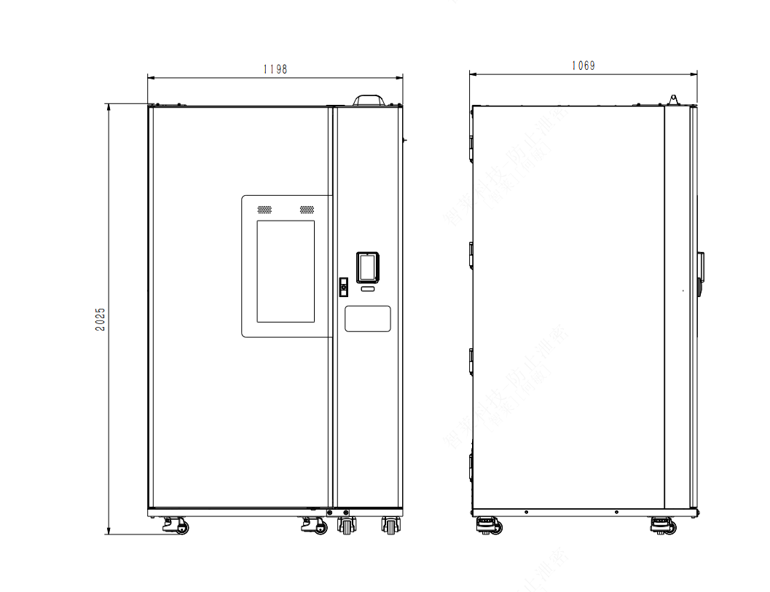
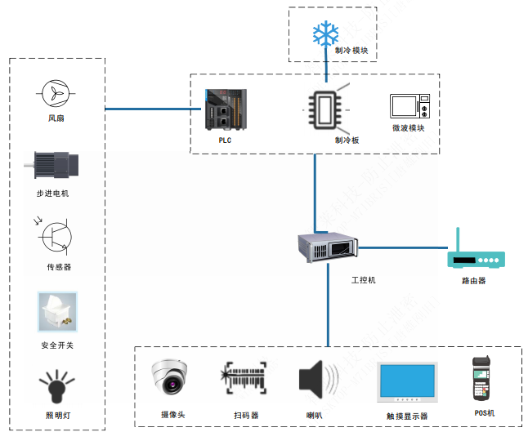
Pizza Vending Machine
Pizza Vending Machine
No. | Item | Parameters
1 | Outer dimension | 1198mm*1069mm* 2025m (W*D*H)
2 | Battery power | 68 boxes; 4 columns and 17 layers
3 | Weight | 600Kg
4 | Rated voltage | 220V/50Hz(EU)、110V/,60Hz(US)
5 | Rated power | 2800W
6 | Display | 21.5” capacitive display
7 | Meal delivery time | Food is delivered 40 seconds after payment is done (average food delivery time; microwave heating time 30s)
8 | Food storage | Temperature control: below 4℃)
9 | Heating method | Microwave heating
10 | Stock management | Automatic stock check by code scanning
11 | Payment method | POS card swiping; code scanning; cash;
12 | Operating system | Android, Windows
Product Specification
Product Features
Highly automated; smart operation interface; no human intervention required for the whole process of ordering, cooking and selling; more efficient delivery and better service quality;
Module design: easier installation and maintenance. Insulation:
Protection mechanism: safer dual protection mechanism: mechanical and electrical protections at pickup slot; reduced labor cost; higher efficiency; less waiting time; customized service available.
System solution
Refrigeration module
Fan
Refrigeration board
Microwave module
Stepper motor
Sensor
IPC
Router
Safety switch
Light
Camera
Scanner
Speaker
Touch screen
POS machine

